Slide 1
COMPUTER ORGANIZATION AND ARCHITECTURE
2. ALU UNIT

Slide 2
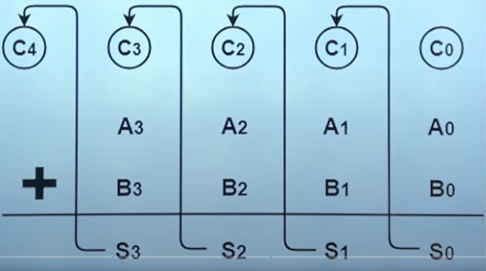
FULL ADDER
A Logic circuit which performs the arithmetic sum and it’s the part of ALU unit.

Slide 3
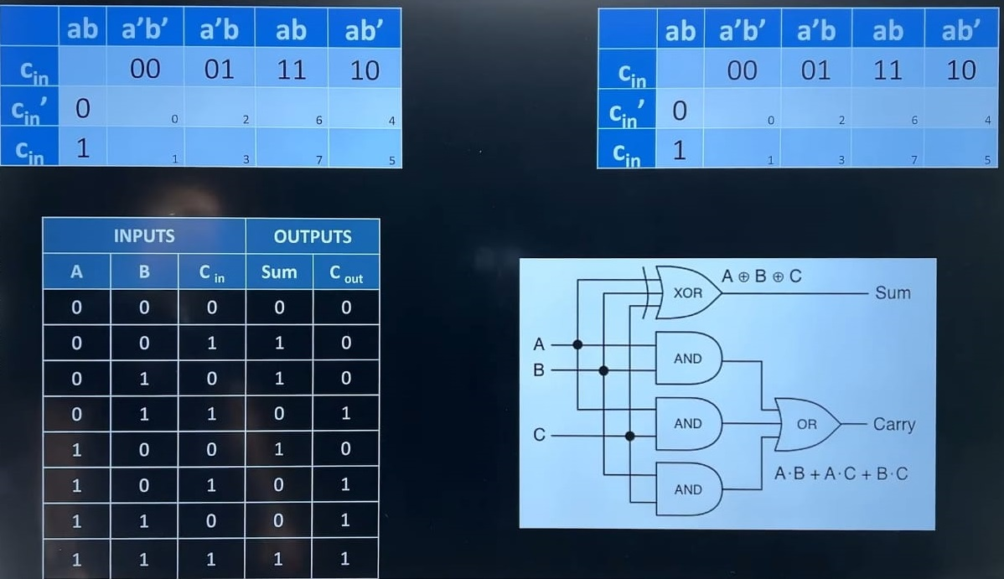

Slide 4
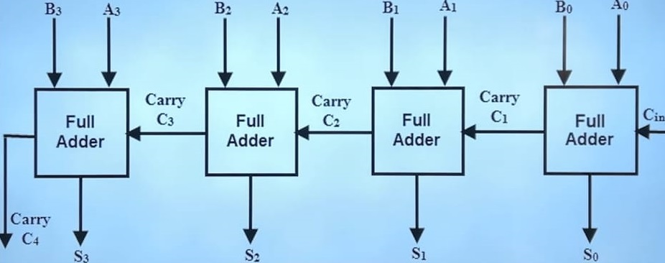
FOUR BIT RIPPLE ADDER/ SUBTRACTOR:
The subtraction can be done with 2’s complement of B and adding it to A.

Slide 5
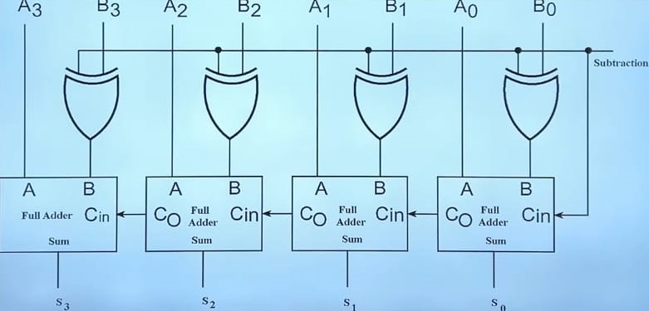
M controls the operation, M= 0 is like adder which means B EXOR 0 = B only,
While M= 1 will behave like; B EXOR 1 = Complement of B . Inputs are
complemented and 1 is added through the carry.

Slide 6
PROBLEMS:
Carry Propagation
Solution:
Look Ahead Carry Generator (Hardware Solution)

Slide 7
BASIC BINARY MULTIPLICATION:
1010*0110

Slide 8
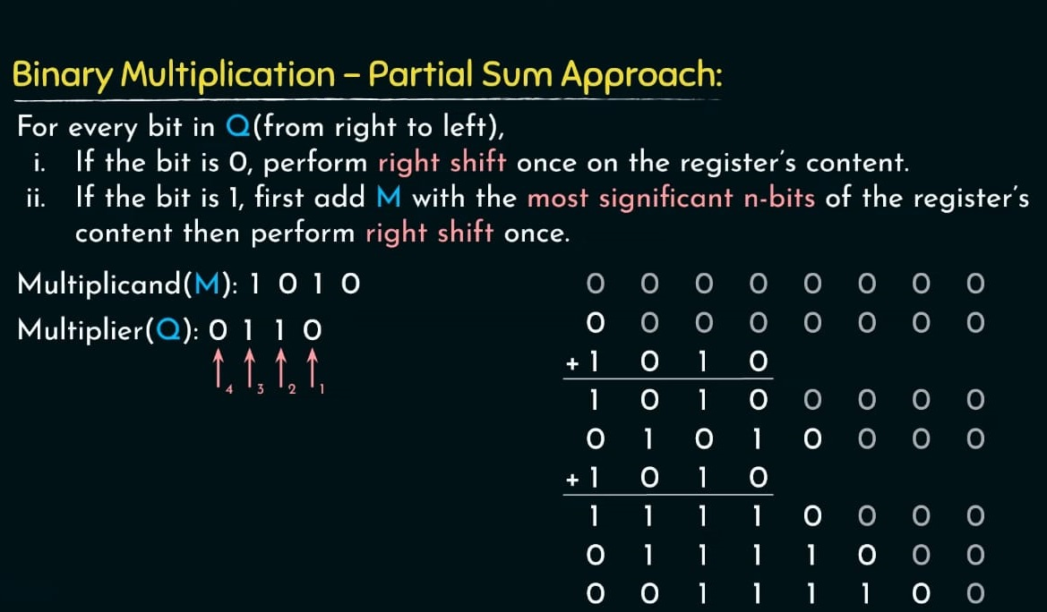
PARTIAL SUM APPROACH:
|M|: n-bits; |Q|: n-bits
|M*Q|: (n+n)= 2n-bits (in worst case)

Slide 9
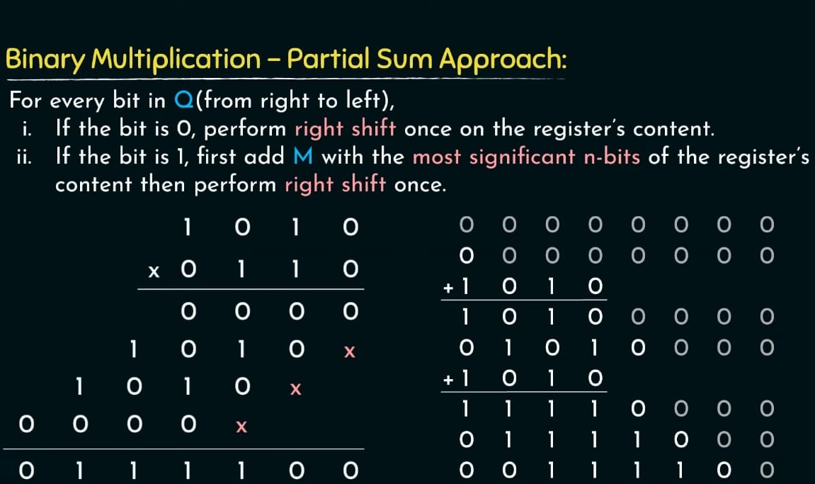
COMPARISON:

Slide 10
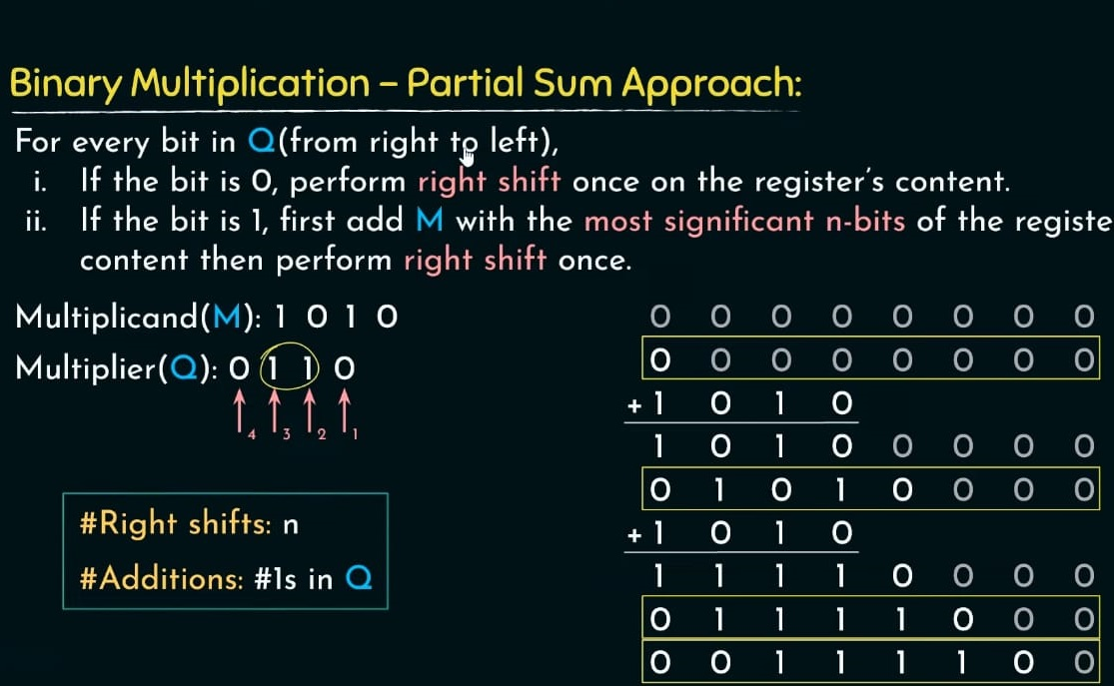
ANALYSIS OF PARTIAL SUM APPROACH:

Slide 11
BOOTH’S ALGORITHMS (1950):
Andrew Donald Booth (1918-2009), was a British electrical engineer, physicist. Was an early developer of magnetic Drum memory for computers. He is known for Booth’s multiplication algorithm.
Booth’s algorithm optimizes binary multiplication by reducing the number of addition and subtractions based on the multiplier bits.
It involves examining the multiplier bits, then either adding, subtracting or leaving the multiplicand unchanged before shifting the partial product.

Slide 12
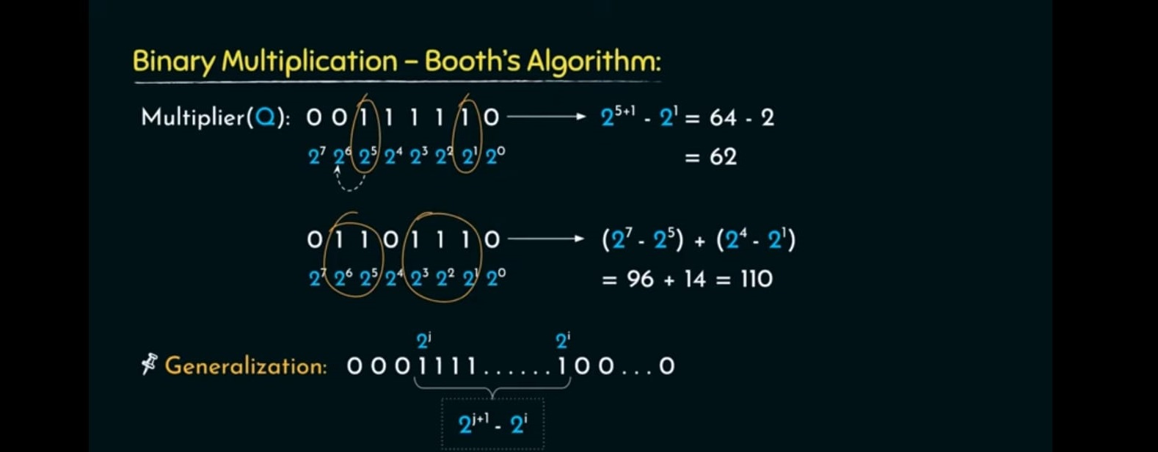

Slide 13
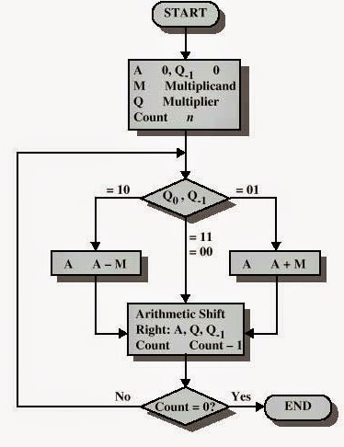
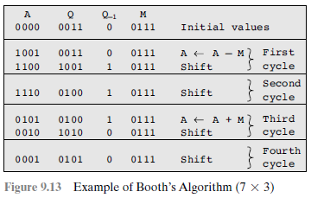
EXAMPLE:

Slide 14
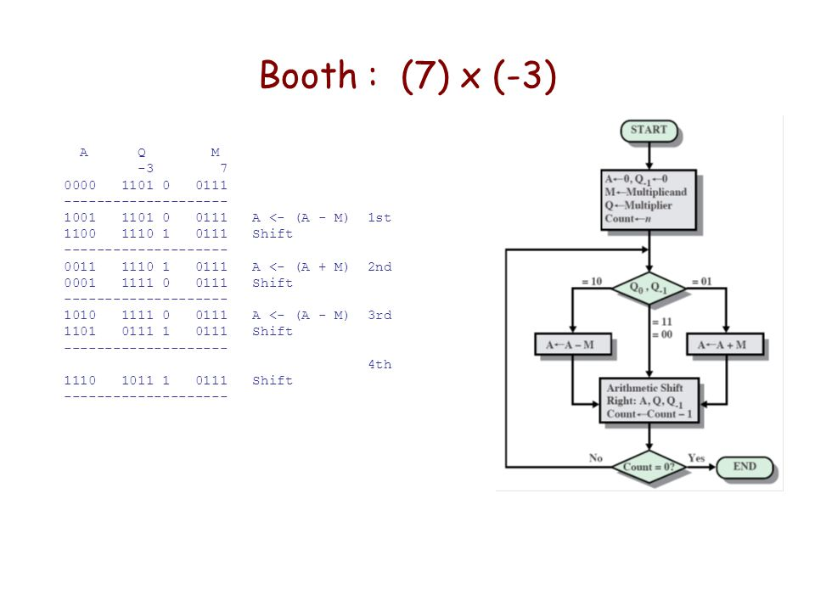

Slide 15
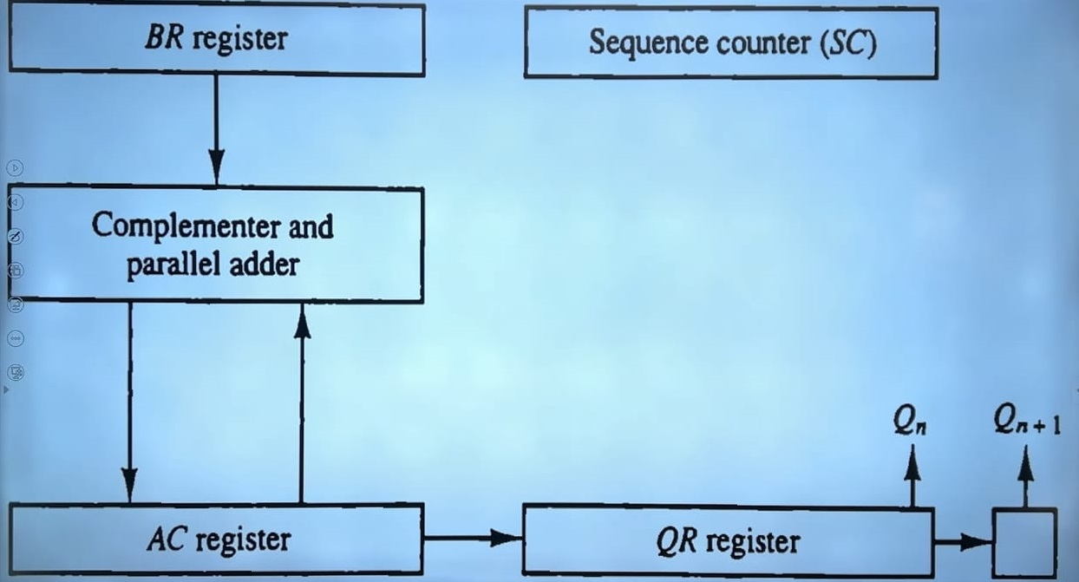
HARDWARE IMPLEMENTATION OF BOOTH’S ALGORITHM :

Slide 16
ARRAY MULTIPLIER:
Uses a grid full of HA’s and FA’s to perform the simultaneous addition of product terms.
AND gates are used to form these product terms before they are fed to the adder array
It forms the product bits all at once, making the operation faster.
Speed advantage comes at a cost of requiring large number of gates, which became economical with the advent of integrated circuits.

Slide 17
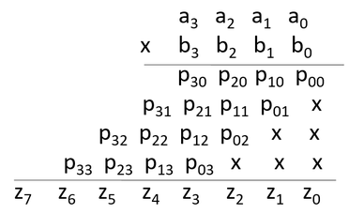
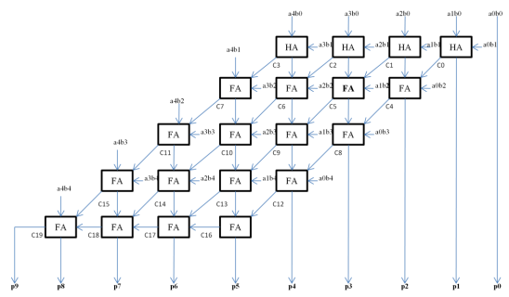
ARCHITECTURE:

Slide 18
DIVISION:
Can be grouped into two classes.
Slow Algorithms- Restoring Division and Non-Restoring Division Algorithms
Fast Algorithms- Division by Series Expansion and Newton-Raphson Division.

Slide 19
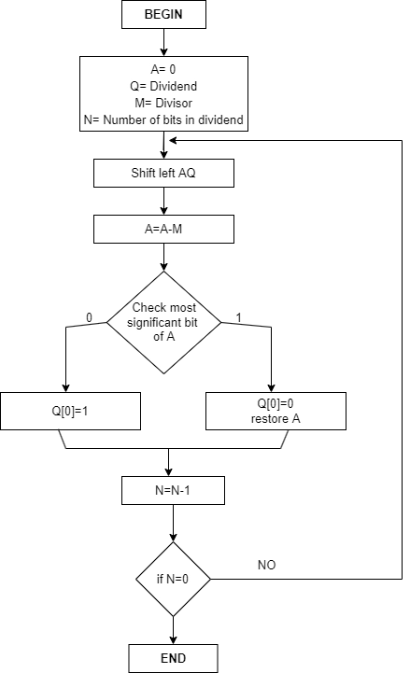
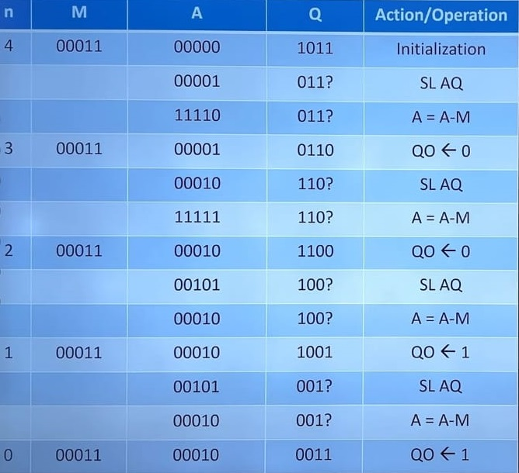
RESTORING DIVISION ALGORITHM (11/3):
Quotient is in register Q while remainder will be in register A

Slide 20
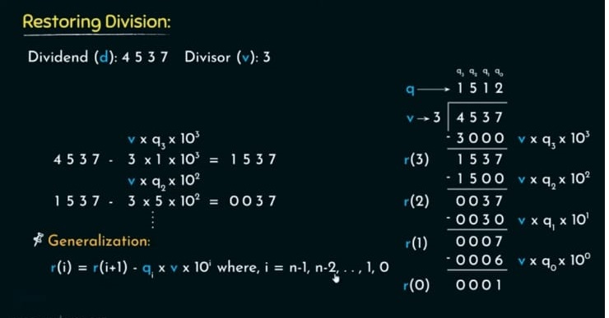
ANALYSIS OF RESTORING DIVISION:

Slide 21
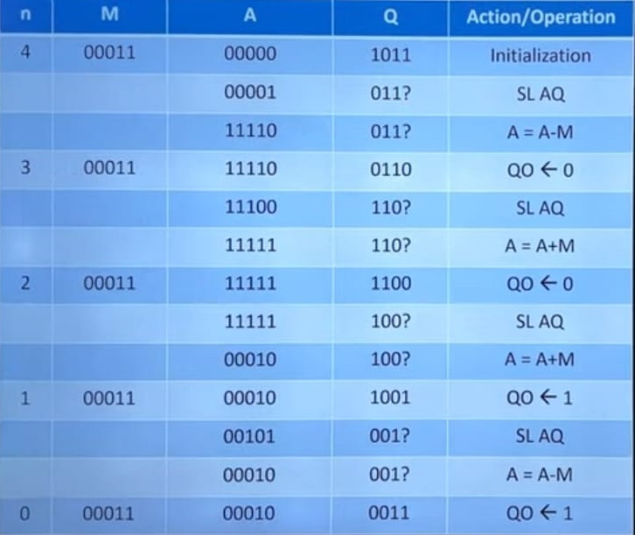
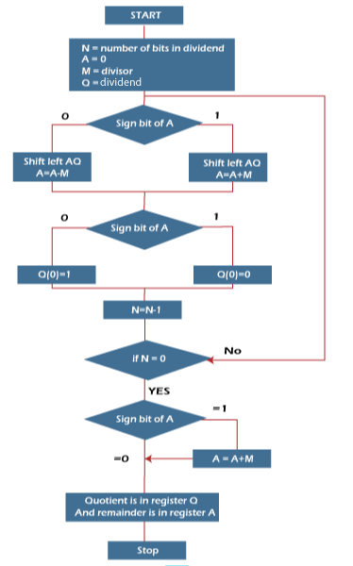
NON-RESTORING DIVISION ALGORITHM (11/3)

Slide 22
PERFORMANCE COMPARISON OF RESTORING AND NON-RESTORING:
Restoring | Non-Restoring
The quotient bits are initially set to zero and then adjusted based on the remainder. | The divisor is subtracted from the dividend, and the result is examined to determine the next quotient bit.
It requires more hardware and more complex control logic compared to non-restoring division. | generally faster than restoring division because it doesn't always correct the quotient towards the correct result.
Always corrects the quotient towards the correct result, which can make it more accurate but slower. | Has simpler hardware requirements and control logic compared to restoring division.
Usually slower compared to non-restoring division due to the extra correction steps | Requires more steps on average to reach the correct quotient compared to restoring division.

Slide 23
BASIC UNDERSTANDING OF NUMBER SYSTEM:
Add (-35) and (-31) in binary using 8-bit registers, in signed 1’s complement and signed 2’s complement.

Slide 24
FLOATING POINT REPRESENTATION:
Problem with casual representation methods is that it do not works well if the number is too small or too large, it takes large amount of memory.
Example: 6.023*10²³
Floating point representation says that we can use the same concept for binary as well, as we do in decimal format. We can store the mantissa and exponent in separate.
Range of true exponent is -2^{k-1}to +2^{k-1}-1 (Ex. For 8 bit -128 to +127). After adding 2^{k-1} , new range goes from 0 to 2^{k}-1

Slide 25
EXAMPLE:
Represent (-21.75) in floating point representation. (s=1, k=7, m=8)

Slide 26
FLOATING POINT REPRESENTATION (CONT.):
FP represents a special kind of sign magnitude representation.
Stored in mantissa/exponent form i.e., m*r^{e}
Mantissa is signed magnitude fraction for most of the cases.
The exponent is stored in bias form.

Slide 27
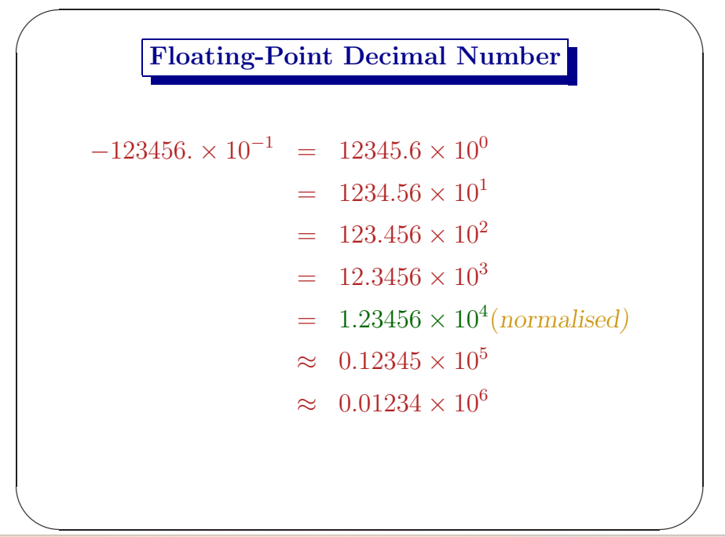

Slide 28
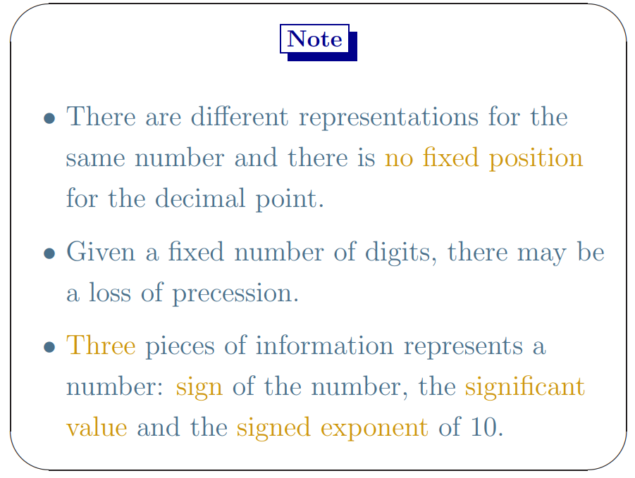

Slide 29
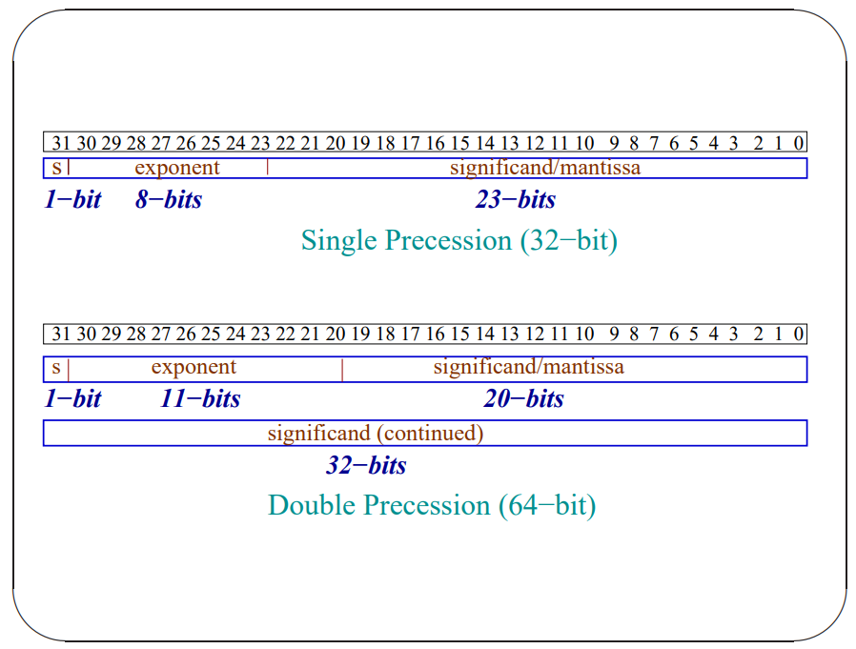

Slide 30
DIFFERENCE BETWEEN SINGLE AND DOUBLE PRECISION:
 | Single Precision | Double Precision
Number of bits | Uses 32 bits to represent a floating-point number. | Uses 64 bits to represent a floating-point number.
Precision | Provides approximately 7 decimal digits of precision | Provides approximately 15-16 decimal digits of precision.
Range | Covers a smaller range of numbers compared to double precision | Covers a wider range of numbers, including larger and smaller values, compared to single precision.
Memory | Consumes less memory | Requires more memory
Accuracy | Offers less accuracy compared to double precision | Provides higher accuracy
Performance | Can be faster to process compared to double precision, especially on hardware that is optimized for single-precision operations. | May require more processing time due to the larger size of the numbers and the higher precision.
Note: The choice between single and double precision depends on the specific requirements of the application, including accuracy, memory usage, and computational performance.

Slide 31
IEEE 754 FLOATING POINT STANDARD (1985):
IEEE standard for floating-point arithmetic (IEEE 754) is a technical standard for floating point arithmetic established in 1985 by IEEE.
It addresses many problems found in the diverse floating-point implementation that made them difficult to use reliably and portably.
Most of the hardware floating point units use the IEEE 754 standard.

Slide 32
IEEE 754 FLOATING POINT STANDARD (CONT):
It gives provision for +-0 and +-∞ (by reserving certain pattern for mantissa and exponent).
There are number of modes for storage from half precision 16 to very lengthy notation.
The floating-point number can be stored either in implicit normalize form or in fractional form.
If the biased exponent bit is K-bits then Bias is 2^{k-1}-1.
If certain Mantissa/Exponent pattern does not denote any number. (NAN i.e., not a number)

Slide 33
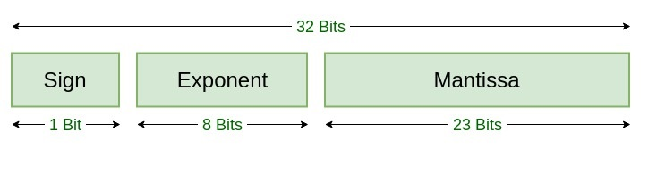
IEEE 754:
Name | Common Name | Mantissa Bits (M) | Exponent Bits (K) | Exponent Bias (2^{k-1}-1)
binary16 | Half Precision | 10 | 5 | 2⁵⁻¹-1 = 15
binary32 | Single Precision | 23 | 8 | 2⁸⁻¹-1 = 127
binary64 | Double Precision | 52 | 11 | 2¹¹⁻¹-1 =1023
binary128 | Quadruple Precision | 112 | 15 | 2¹⁵⁻¹-1 = 16383
binary256 | Octuple Precision | 236 | 19 | 2¹⁹⁻¹-1 = 262143

Slide 34
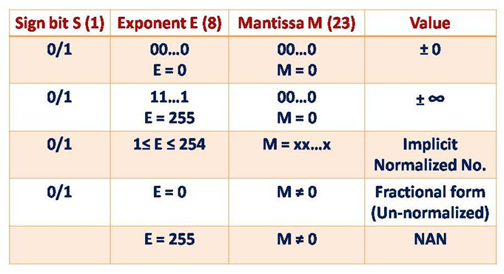

Slide 35
EXAMPLE 1:
Consider the number is in IEEE 754 single precision and bias is 127, identify the number.
S = 1, E = 10000001, F = 11110000000000000000000

Slide 36
EXAMPLE 2:
Given number is in 32-bit single precision.
00111110011011010000000000000000
Can you tell the number in Decimal.

Slide 37
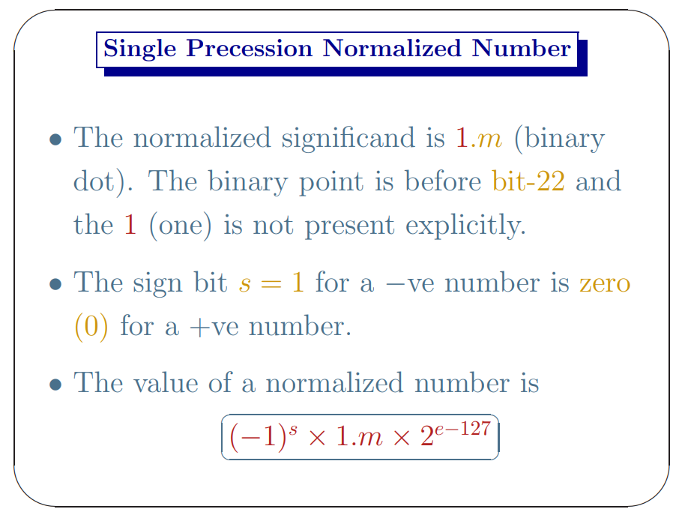

Slide 38
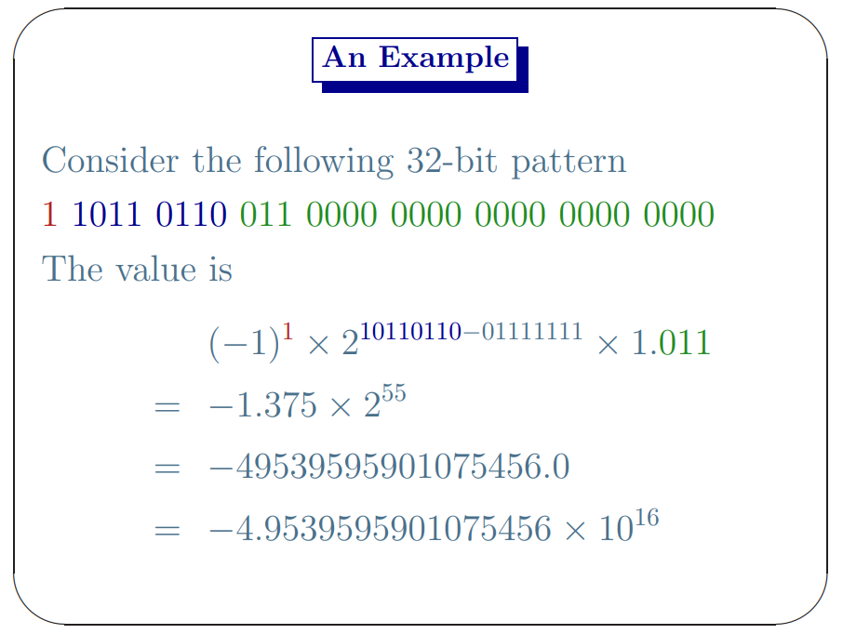

Slide 40
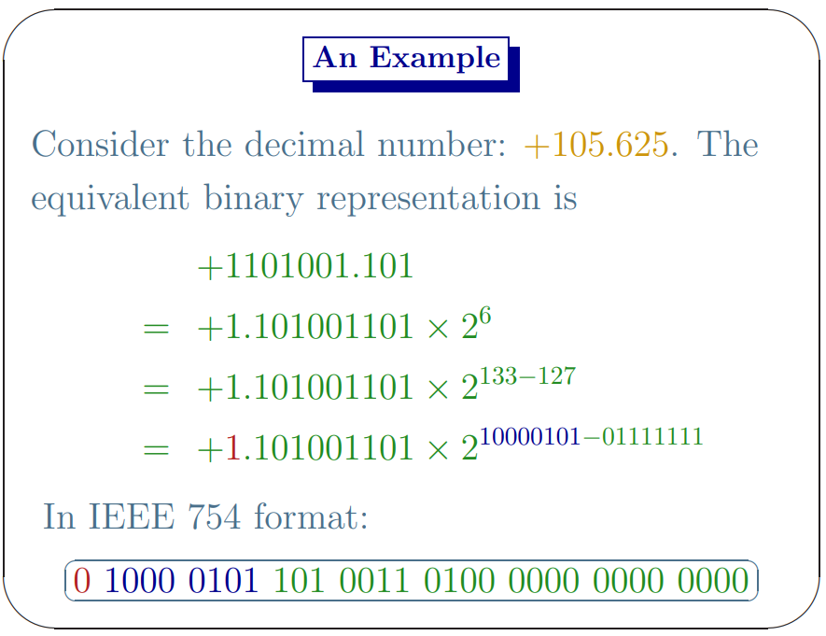

Slide 42
